Slide 1
JavaScript Validation con’t

Slide 2
JavaScript Reusability
Functions are reusable blocks of code
Any new function that you want to create should be in a separate JavaScript file
Ease of bug tracking
Reusing same functions across multiple pages
Code Readability
Manageable to push updates
Cached JavaScript files can speed up page loads
Creation of custom libraries

Slide 3
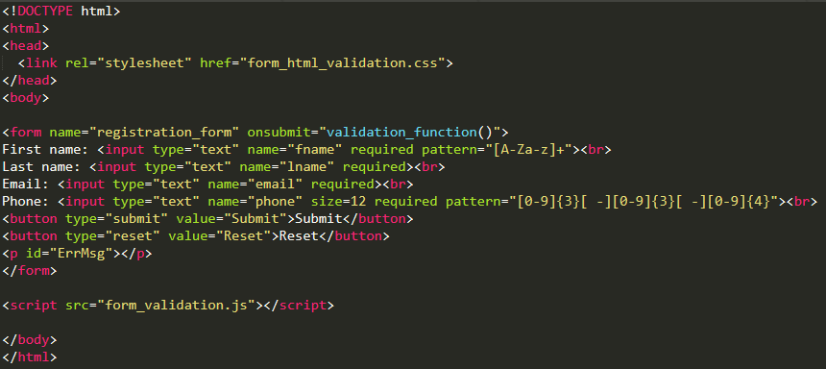
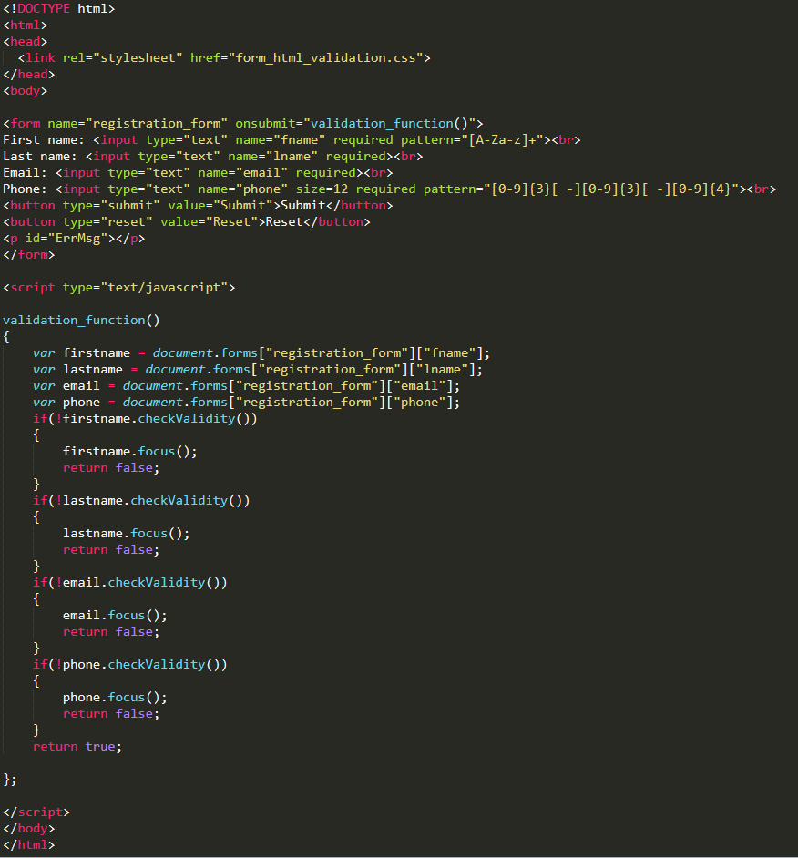
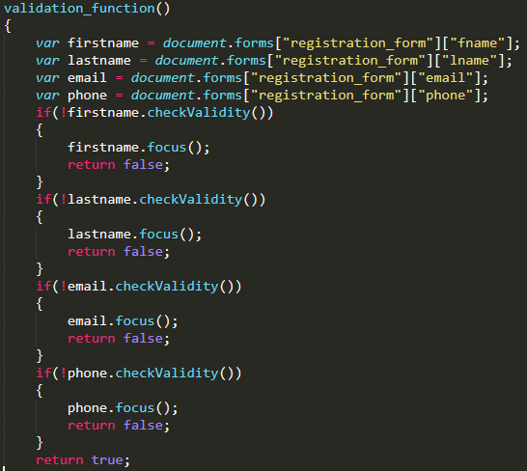
Recap: How to keep JavaScript in a separate file

Slide 4
Things to think about
Use of parameters to pass information
Example
One set of JS Form Validation Functions can be used across all forms on a site as long as you are able to pass the form name as a parameter to the function
Clearly and strictly defining input and output of each function
Try to ensure that there is minimal code repeatability
Copy paste errors
Fixing same problem across many functions
Testing and Debugging

Slide 5
Server Side Programming

Slide 6




Request to a Static Page
Look up a specific page
Send back an HTTP Response
HTTP Request: GET www.xkcd.com
You (client)
Web server
IP: 72.26.203.99
HTTP Response: web content (HTML file) Client-side code: HTML, CSS, JavaScript

Slide 7
Request to a Dynamic Page
The server must respond dynamically if it needs to provide different client-side code depending on the situation
Date and time
Specifics of the user’s request
Database contents – forms and authentication
Get your request information
Look up information related to you
Generate content
Send back HTTP Response
HTTP Request: GET www.facebook.com
You (client)
Web server
HTTP Response: web content (HTML file) Client-side code: HTML, CSS, JavaScript (dynamically generated by server)

Slide 8
HTTP Response Code Categories
1XX
informational
2XX
success
3XX
redirect
4XX
client error
5XX
server error

Slide 9
HTTP Response Common Codes
200 OK
request succeeded, resource is in message body
404 Not Found
resource does not exist
500 Server Error
general server error

Slide 10
Server Side Technologies
PHP
Perl
.Net
Ruby
Java

Slide 11
Common Server Side Frameworks
Symfony for PHP
Django for Python
Express for Node.js
Ruby on Rails
Grails for Java
Catalyst/Mojolicious for Perl

Slide 12
Selection of Server Side Framework Factors
Difficulty to learn
Efficiency/Productivity
Performance
Caching
Scalability (e.g., performance, load distribution)
Web security (e.g., form sanitization)

Slide 14
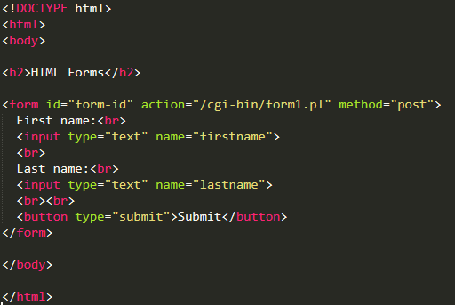
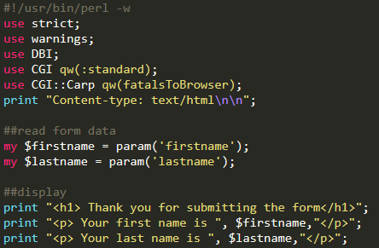
Example of a Form with a Perl Server Side Script Link
form.html
form1.pl

Slide 15
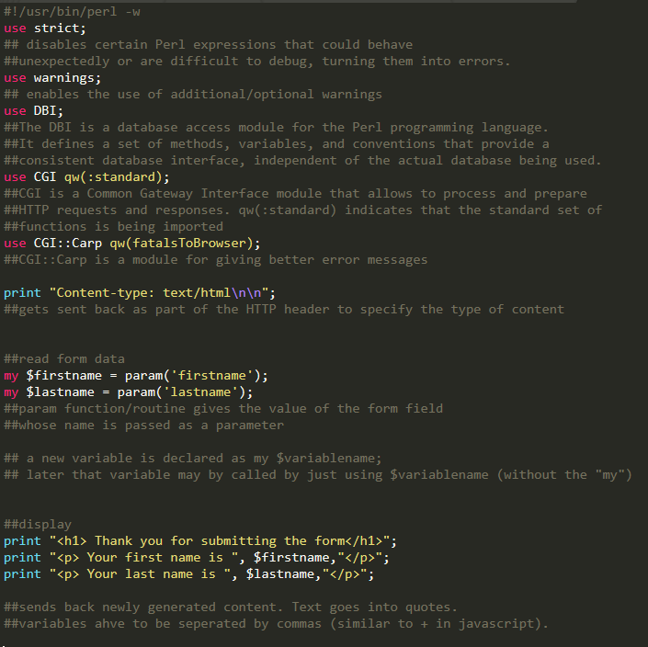
Take a closer look at the Perl script

Slide 16
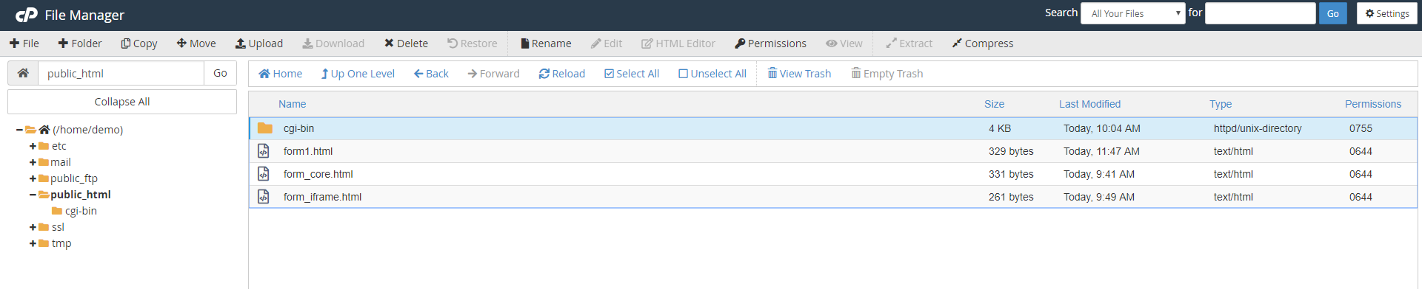
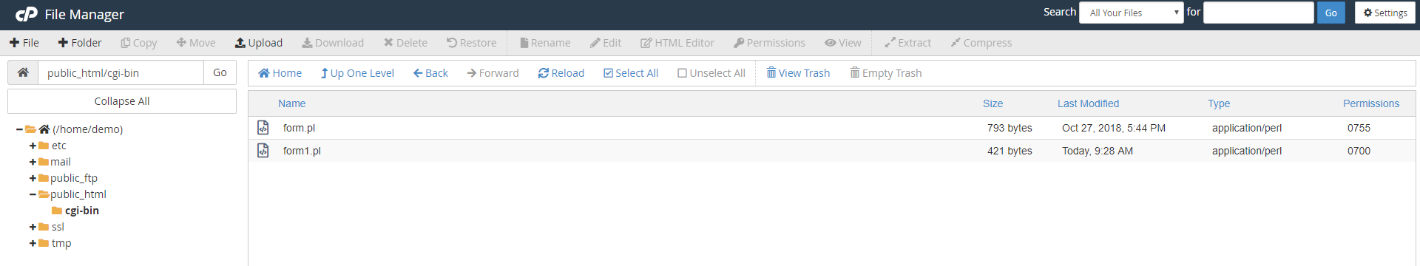
Placement of the script

Slide 17
Permissions on files
3 actions can be performed on any file
Read
Write
Execute
There are three types of users
Owner
Group
World
Value | Meaning
777 | No restrictions on permissions. Anybody may do anything. Generally not a desirable setting.
755 | The file's owner may read, write, and execute the file. All others may read and execute the file. This setting is common for programs that are used by all users.
700 | The file's owner may read, write, and execute the file. Nobody else has any rights. This setting is useful for programs that only the owner may use and must be kept private from others.
666 | All users may read and write the file.
644 | The owner may read and write a file, while all others may only read the file. A common setting for data files that everybody may read, but only the owner may change.
600 | The owner may read and write a file. All others have no rights. A common setting for data files that the owner wants to keep private.

Slide 18
Permission of the script
Value | Meaning
777 | No restrictions on permissions. Anybody may do anything. Generally not a desirable setting.
755 | The file's owner may read, write, and execute the file. All others may read and execute the file. This setting is common for programs that are used by all users.
700 | The file's owner may read, write, and execute the file. Nobody else has any rights. This setting is useful for programs that only the owner may use and must be kept private from others.
666 | All users may read and write the file.
644 | The owner may read and write a file, while all others may only read the file. A common setting for data files that everybody may read, but only the owner may change.
600 | The owner may read and write a file. All others have no rights. A common setting for data files that the owner wants to keep private.

Slide 19
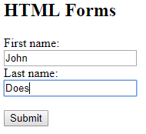

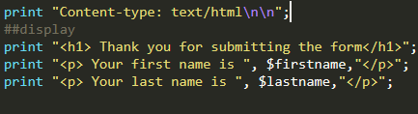
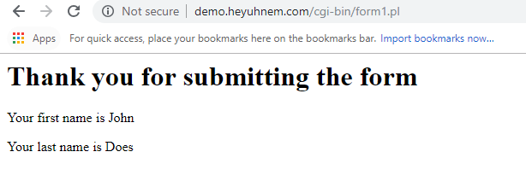
Information Flow
HTML Form gets user input
User submits HTML Form to a script
Script parses the information
Script generates content and sends it back
User receives information that the script generated

Slide 20
DIY: Customize script to accept form we made last class
Take form_extended.html
Make sure action will point to the correct script you make
Make sure method is post
Take form1.pl and edit it in notepad++
Add two additional variables (email and phone) and parse their values using param(). Make sure names of input fields in the form match those in perl file.
Add two more print statements where HTML code is being generated to output the variables being read.
Upload the html document to public_html
Upload the perl script to public_html/cgi-bin and set the correct permissions
Test!

Slide 21
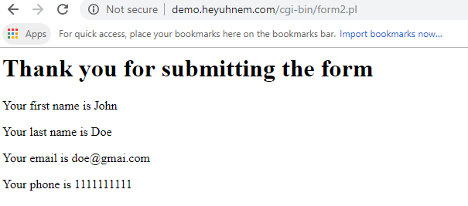
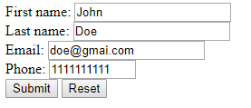
Expected Output

Slide 22
What happened?
Form was filled out
Form was submitted to the server
A server-side script parsed the form field values
A server side script responded with its own page with the parameter values displayed

Slide 23
HTML Iframes
Iframe is used to display an HTML page within an HTML page
Embed third party media (YouTube)
Embed your own media
Embed code examples
Embed third party applets (payment forms)

Slide 24
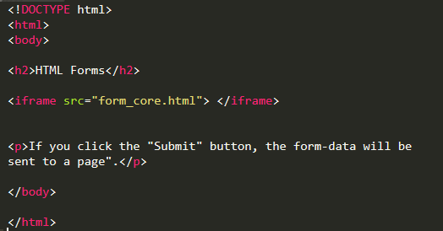
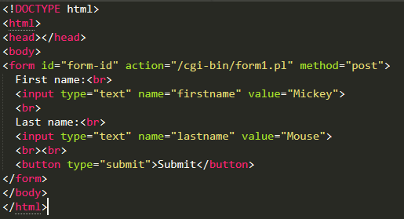
Iframes and forms
You can put your form into an iframe
The basic syntax
<iframe src="URL"></iframe>
index.html
form_core.html

Slide 25
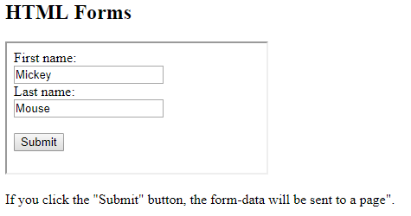
What does the page look like?

Slide 26
Iframe “prettification”
Remove border
frameborder="0"
Set sizing correctly
width="400" height="200"
By default iframe needs to have a specific size. It can be set once statically, or using CSS or JS it can be responsive. Example link.

Slide 27
DIY: Make an iframe
Take form_extended.html and rename it form_iframe.html
Put the actual form into another html file, form_core.html
Using iframe link the form to the form_iframe.html
Upload the html documents to public_html
Make sure your server side script is still set correctly
Test!

Slide 28
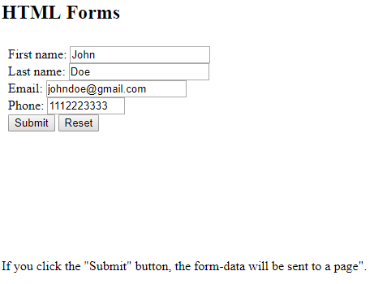
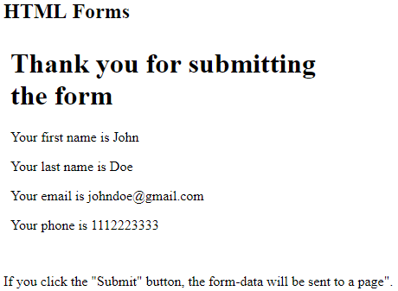
Output

